Slide 1
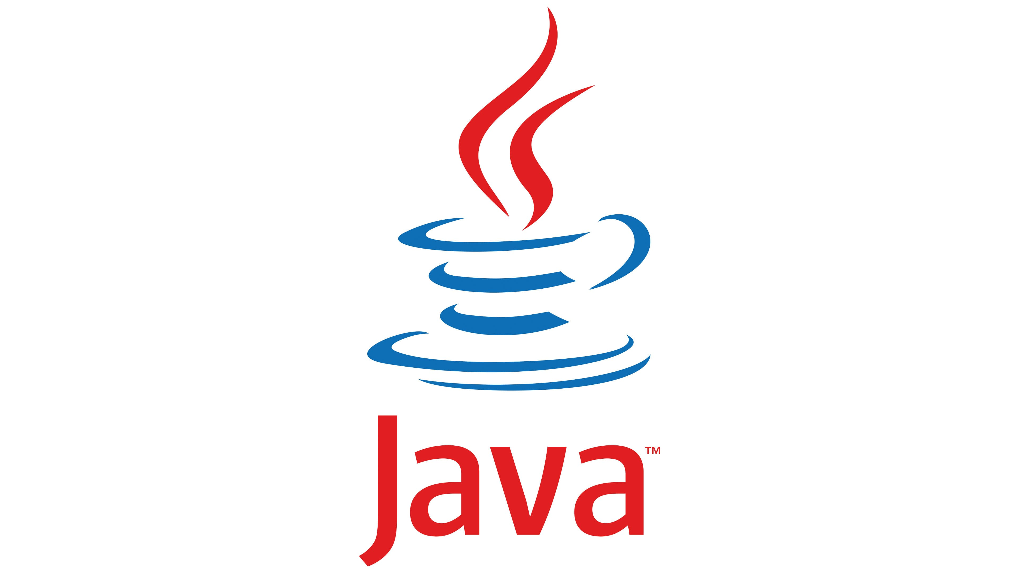
Welcome to the presentation on Java Architecture and OOP’s programming language concepts
-By Dhananjay Kumar B S

Slide 2
CONTENTS
What is JAVA
JAVA Architecture
JVM Architecture
JRE Architecture
JDK Architecture
OOPs
Features of OOPs

Slide 3
What is JAVA
Java is a programming language and a platform. Java is a high-level, robust, object-oriented and secure programming language.
Java was developed by Sun Microsystems (which is now the subsidiary of Oracle) in the year 1995. James Gosling is known as the father of Java. Before Java, its name was Oak. Since Oak was already a registered company, so James Gosling and his team changed the name from Oak to Java.
JAVA-Just Another Virtual Accelerator is the full form of JAVA.

Slide 4
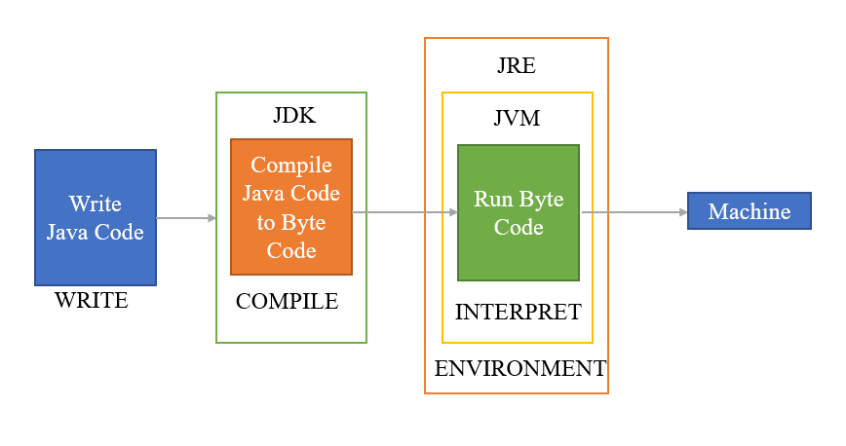
Java Architecture
Java Architecture is a collection of components, i.e., JVM, JRE and JDK. It integrates the process of interpretation and compilation. It defines all the processes involved in creating a Java program.
Java Architecture explains each and every step of how a program is compiled and executed.
Java Architecture can be explained by using the following steps:
There is a process of compilation and interpretation in Java.
Java compiler converts the Java code into byte code.
After that, the JVM converts the byte code into machine code.
The machine code is then executed by the machine.

Slide 5
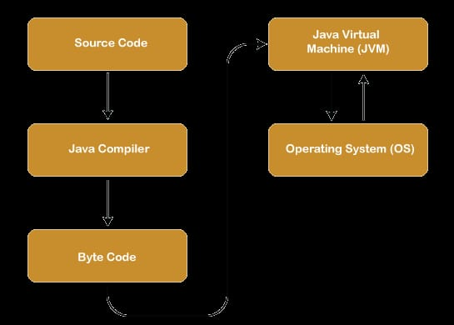
Diagram represents the Java Architecture in which each step is elaborate graphically.

Slide 6
Components of Java Architecture
The Java Architecture includes the three main components:
Java Virtual Machine (JVM)
Java Runtime Environment (JRE)
Java Development Kit (JDK)

Slide 7
Java Virtual Machine (JVM)
The main feature of Java is WORA. WORA stands for Write Once Run Anywhere.
The feature states that we can write our code once and use it anywhere or on any operating system. Our Java program can run any of the platforms only because of the Java Virtual Machine.
It is a Java platform component that gives us an environment to execute java programs.
Its main task is to convert byte code into machine code.

Slide 8
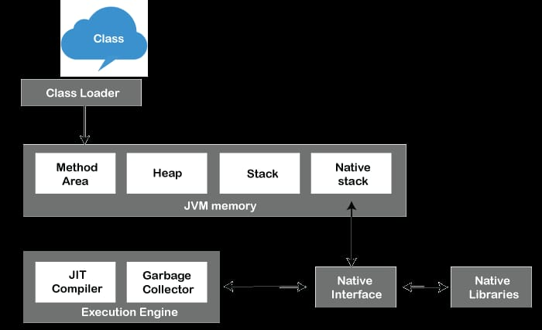
JVM Architecture
JVM is an abstract machine that provides the environment in which Java bytecode is executed. The figure represents the architecture of the JVM.

Slide 9
Continued….
ClassLoader: ClassLoader is a subsystem used to load class files. ClassLoader first loads the Java code whenever we run it.
Class Method Area: Class Method area holds the information of static methods, static blocks, and instance methods.
Heap: The heap area is a part of JVM memory and is created when the JVM starts up. Its size cannot be static because it increase or decrease during the application runs.
Stack: It is also referred to as thread stack. It is created for a single execution thread. The thread uses this area to store the elements like the partial result, local variable, data used for calling method and returns etc.
Native Stack: It contains the information of all the native methods used in our application.
Execution Engine: It is the central part of the JVM. Its main task is to execute the byte code and execute the Java classes. The execution engine has three main components used for executing Java classes.

Slide 10
Continued……
Interpreter: It converts the byte code into native code and executes. It sequentially executes the code. The interpreter interprets continuously and even the same method multiple times. This reduces the performance of the system, and to solve this, the JIT compiler is introduced.
JIT compiler: JIT compiler is introduced to remove the drawback of the interpreter. It increases the speed of execution and improves performance.
Garbage Collector: The garbage collector is used to manage the memory, and it is a program written in Java. It works in two phases, i.e., Mark and Sweep. Mark is an area where the garbage collector identifies the used and unused chunks of memory. The Sweep removes the identified object from the Mark.
Java Native Interface
Java Native Interface works as a mediator between Java method calls and native libraries.

Slide 11
Java Runtime Environment (JRE)
The Java Runtime Environment (JRE) is software that Java programs require to run correctly. Java is a computer language that powers run current web and mobile applications. The JRE is the underlying technology that communicates between the Java program and the operating system.
JRE is like a supporting actor that ensures Java applications have everything they need to perform their best.

Slide 12
Components of JRE
Java Virtual Machine (JVM): JVM acts as the director, translating Java code into a language that the computer understands. Imagine JVM as a translator at the United Nations. It listens to speeches in different languages and translate them for everyone to understand.
Java Class Libraries: JRE provides a library of ready-to-use code modules that simplify application development and solve common programming challenges. Java Class Libraries are like a toolbox filled with tools. Developers can borrow these tools instead of building everything from scratch, saving time and effort.
Runtime Environment: JRE creates a comfortable environment for Java applications to perform their best, taking care of memory management, garbage collection, and security. Think of the runtime environment as a well-equipped kitchen where chefs can focus on cooking delicious meals without worrying about ingredient availability or kitchen cleanliness.

Slide 13
Java Development Kit (JDK)
JDK is an acronym for Java Development Kit. The Java Development Kit (JDK) is a software development environment which is used to develop java applications and applets. It physically exists. It contains JRE + development tools.
The JDK contains a private Java Virtual Machine (JVM) and a few other resources such as an interpreter/loader (Java), a compiler (javac), an archiver (jar), a documentation generator (Javadoc) etc. to complete the development of a Java Application.

Slide 14
Continued….
The JDK includes various tools that help in the development process:
Java Compiler
Javadoc
Jar(java Archive)
JDB (Java Debugger)

Slide 15
OOPs (Object-Oriented Programming)
Object-Oriented Programming or Java OOPs concept refers to languages that use objects in programming, they use objects as a primary source to implement what is to happen in the code. Objects ae seen by the viewer or user, performing tasks you assign.
Object-oriented programming aims to implement real-world entities like inheritance, hiding, polymorphism, etc. is to bind together the data the functions that operate on them so that no other part of the code can access this data except that function.

Slide 16
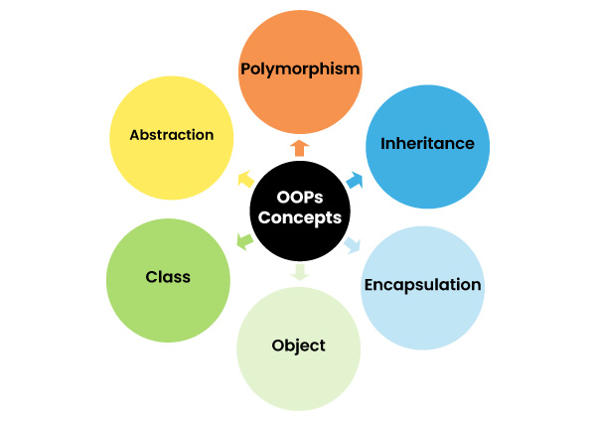
Java OOPs
OOPs concepts are as follows:
Object
Class
Inheritance
Polymorphism
Abstraction
Encapsulation

Slide 17
Object
An object is an entity that has two characteristics (states and behavior).
Some of the real-world objects are book, mobile, table, computer, etc.
An object a variable of the type class, it is a basic component of an object-oriented programming system.
A class has the methods and data members (attributes), these methods and data members are accessed through an object. Thus, an object is an instance of a class.

Slide 18
Class
A class is a blueprint from which individual objects are created (or, we can say a class is a data type of an object type).
In Java, everything is related to classes and objects.
Each class has its methods and attributes that can be accessed and manipulated through the objects.

Slide 19
Inheritance
Inheritance is a process by which we can reuse the functionalities of existing classes to new classes.
In the concept of inheritance, there are two terms base (parent) class and derived class.
When a class is inherited from another class (base class), it (derived class) obtains all the properties and behaviors of the base class.
Types of Inheritance are
Single-level Inheritance
Multi-level Inheritance
Hierarchical Inheritance
Multiple Inheritance
Hybrid Inheritance

Slide 20
Polymorphism
The term “polymorphism” means “many forms”.
Polymorphism is useful when you want to create multiple forms with the same name of a single entity.
To implement polymorphism in Java, we use two concepts method overloading and method overriding.
The method overloading is performed in the same class where we have multiple methods with the same name but different parameters.
The method overriding is performed by using the inheritance where we can have multiple methods with the same name in the parent and child classes.

Slide 21
Abstraction
An abstraction is a technique of hiding internal details and showing functionalities.
The abstract classes and interfaces are used to achieve abstraction in Java.
The real-world example of an abstraction is a Car, the internal details such as the engine, process of starting a car, process of shifting gears, etc. are hidden from the user, and features such as the start button, gears, display, break, etc are given to the user.
When we perform any action on these features, the internal process works.

Slide 22
Encapsulation
Encapsulation is a process of binding the data members (attributes) and methods together.
The encapsulation restricts direct access to important data.
The best example of the encapsulation concept is making a class where the data members are private and methods are public to access through an object.
In this case, only methods can access those private data.

Slide 23
Advantages of OOPs Concept
The implementation of OOPs concepts are easier.
The execution of the OOPs is faster than procedural-oriented programming.
OOPs provide code reusability so that a programmer can reuse an existing code.
OOPs help us to keep the important data hidden.

